Slide 1
Project ontwerp
By Alexander Petry

Slide 2
Table of contents
What is the project
How is it made
What is it is supposed to do
What does it do
What would I change

Slide 3
What is the project
Goal: Soldering station
Requirements:
Adjustable temperature
Display temperature

Slide 4
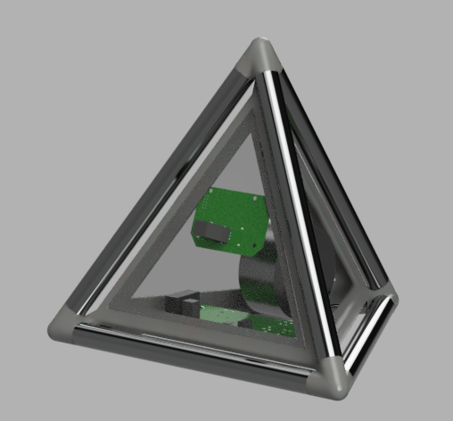
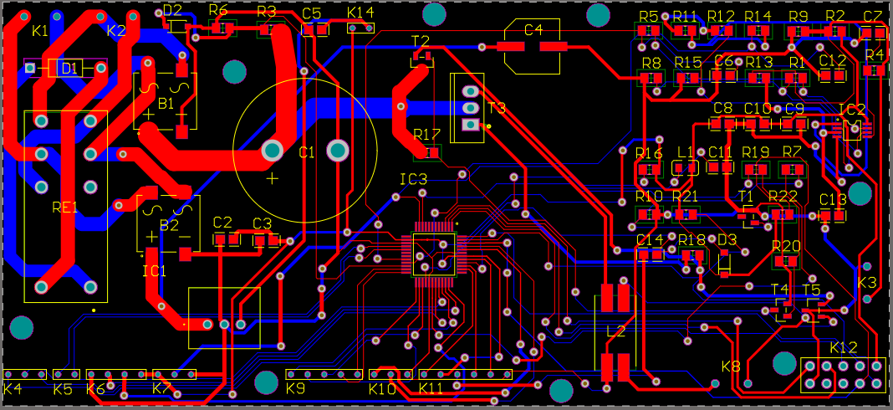
How it is made
Electrical
Altium
JLCPCB
Components
Mechanical
3D printed
Lasercut

Slide 5
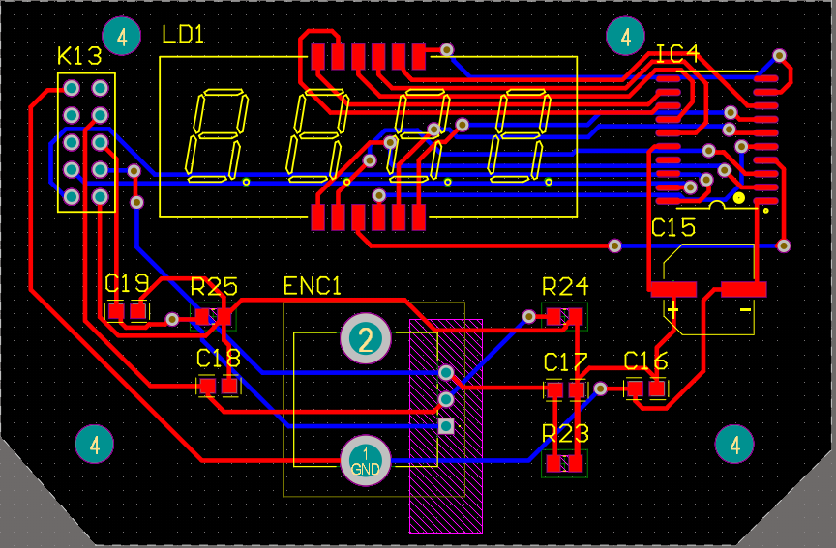
What it is supposed to do
Display temperature
Adjust temperature

Slide 6
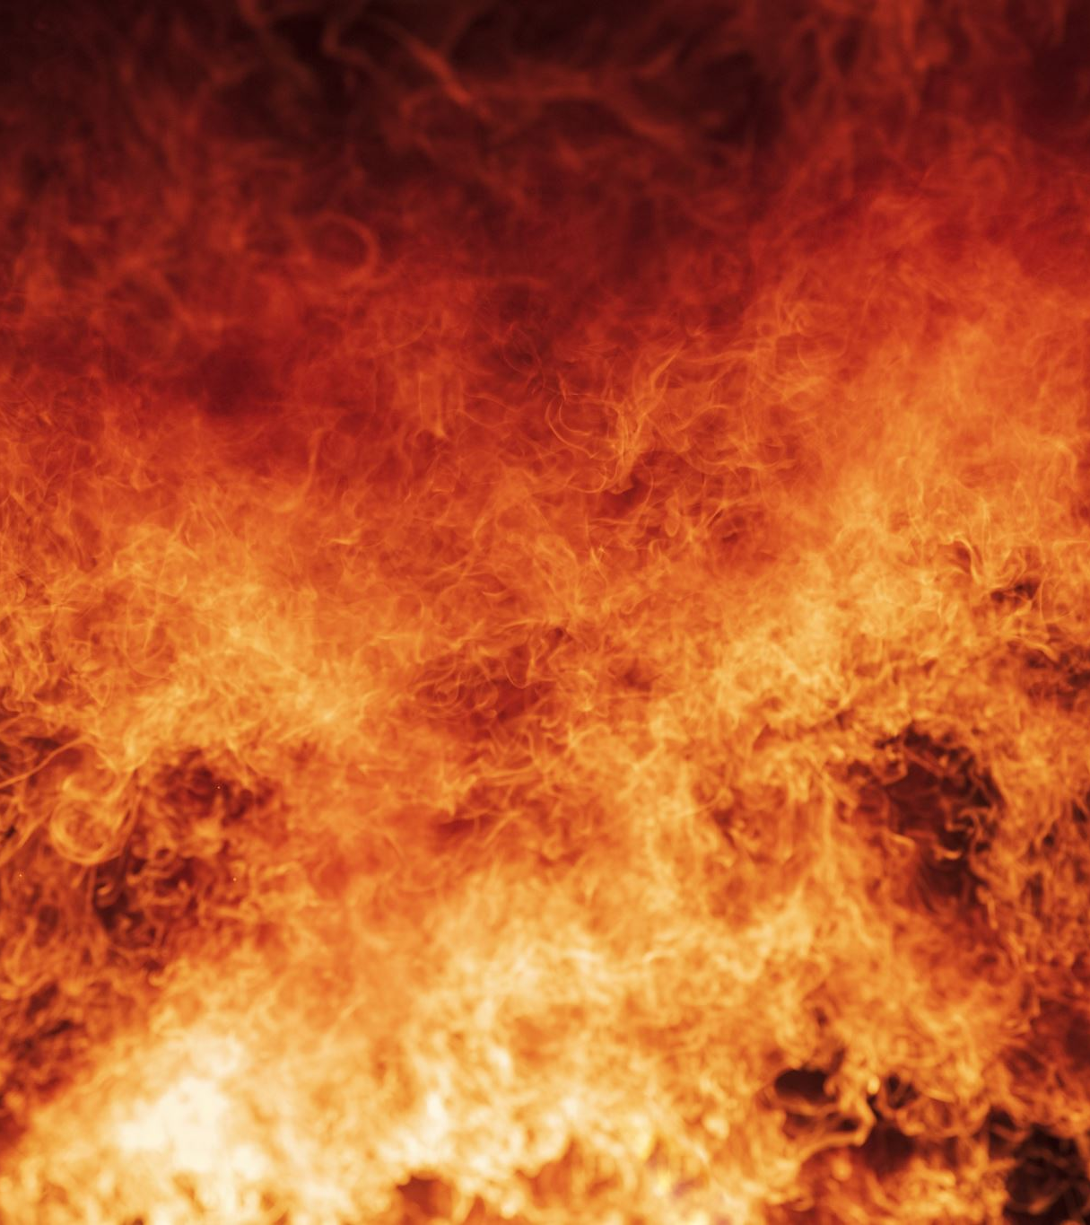
What it does
burns

Slide 7
What would I change
Electrical schematic
Soldering
Case design
Project

